Slide 1
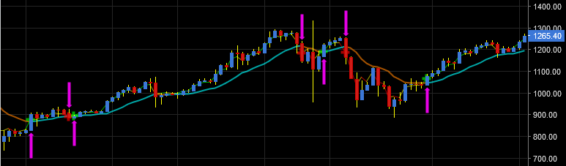
Algorithmic Trading with Bitcoin
Alexis Candelaria
Emmanuel Mendoza
Stephen Piazza
Victor Fateh

Slide 2
Project Goals
Collect real time trading data to use with our trading agent.
Implement an exchange simulator that feeds the trading data to a trading agent and handles order requests + fees and account balancing.
Implement a trading agent that paper-trades bitcoin based on real data.
Implement a trading strategy that the trading agent will use.
Use a search algorithm to help find optimal parameters for our trading strategy.
Use machine learning to help improve the performance of our trading strategy.

Slide 3
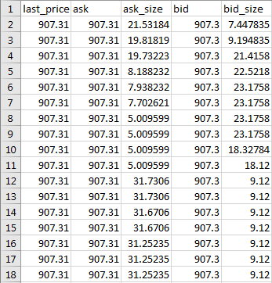

Data Collection
bfx_2017-03-25.csvsv
www.bitfinex.com
Notes:
We used bitfinex websocket api to collect real time trading data of bitcoin and saved this data into a csv file.
Each row represents a 5 second time interval.

Slide 4
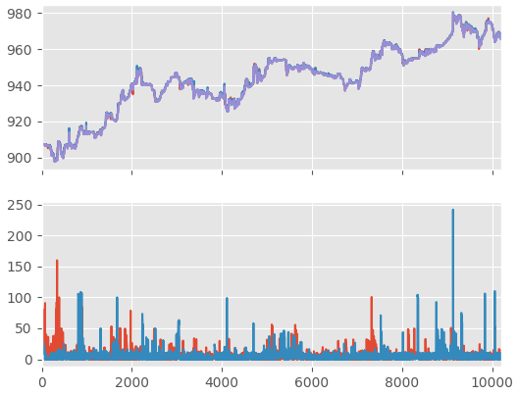
Data Visualization
bfx_2017-03-25.csv

Slide 5
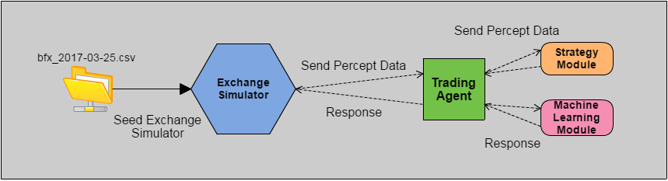
Architecture
Notes:
Exchange simulator takes into account fees, trading agent only does market sell and buy

Slide 6
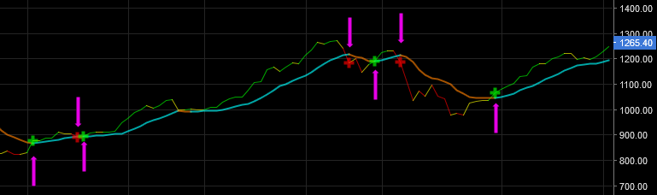
Agent Strategy: EMA Crossover Strategy

Slide 7
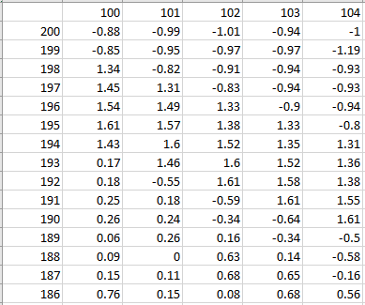
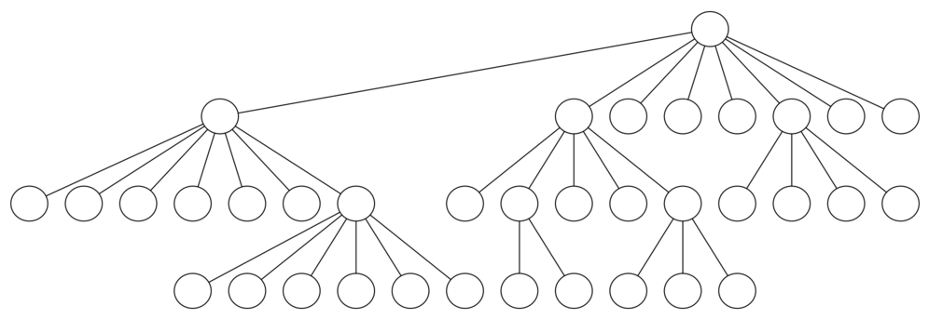
EMA Crossover Strategy:
Using a Search Tree to
Find Localized Optimal EMA Parameters
Short Period EMA
Long Period EMA
Notes:
Two approaches; bruteforced within a boundary or repeated localized searches within a boundary.

Slide 8
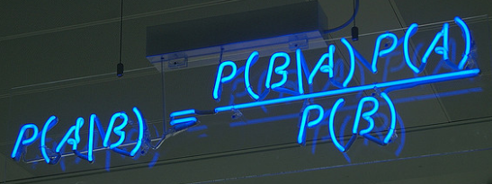
Machine Learning: Naive Bayes Classifier
Notes:
When a trading decision is made, we store all the percepts that were perceived at the moment the trade was executed. Once a future trade is made, we can then evaluate if our past trade was successful by testing if we successfully bought low and sold high. If yes, then we would classify that decision as a success, if no, we would then classify that decision as a fail.

Slide 9
Machine Learning: Naive Bayes Classifier
Notes:
Once we have our training dataset, we then calculate the mean and standard deviation of each percept and summarize it by class. We then use these summaries to evaluate any future decisions and calculate the probability of weather a current trade decision may succeed or fail.

Slide 10
Uptrend Results
EMA Crossover Strategy Only
EMA Short: 132
EMA Long: 196
Result %: 0.57
Start Balance: $ 907.31
Final Balance: $ 912.53
EMA Crossover Strategy
+ Machine Learning
EMA Short: 132
EMA Long: 196
Result %: 3.52
Start Balance: $ 907.31
Final Balance: $ 939.2

Slide 11
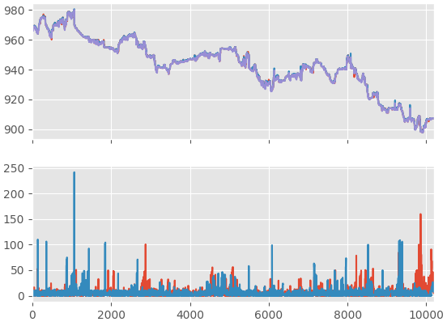
Downtrend Results
EMA Crossover Strategy Only
EMA Short: 130
EMA Long: 191
Result %: -6.15
Start Balance: $ 965.99
Final Balance: $ 906.55
EMA Crossover Strategy
+ Machine Learning
EMA Short: 130
EMA Long: 191
Result %: -2.02
Start Balance: $ 965.99
Final Balance: $ 946.44

Slide 12
Future Work
Try different Percepts
Try different Strategies
Try different ML Algorithms
Notes:
Try different strategies
Try different percepts
Try different machine learning algorithms

